Slide 1
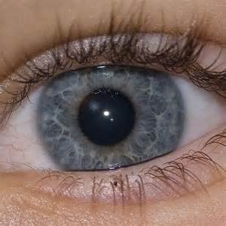
The eye
IGCSE Biology

Slide 2
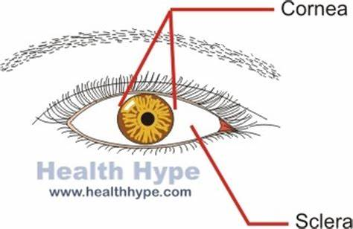
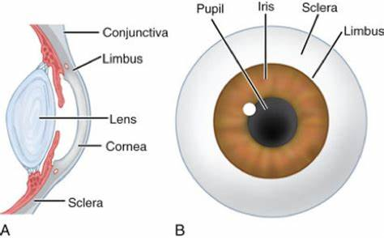
Eyebrow
Eyelash
Eyelid
(NOT required) Limbus: the junction of the opaque sclera and transparent cornea.

Slide 3
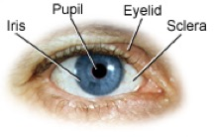
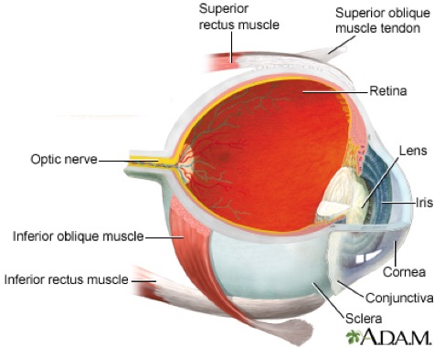
Retina
Choroid
Sclera

Slide 4
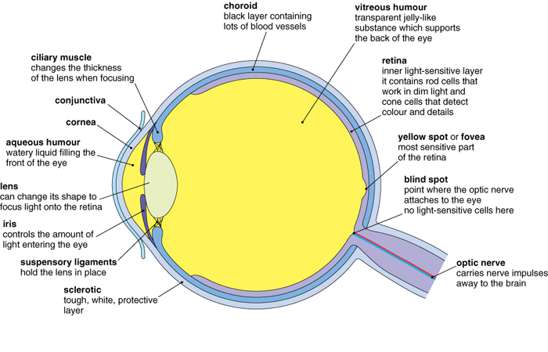
Structure of the eye
Challenging:
Is this side view or top view of an eye?
Is this a left eye or right eye?
Hint: position of fovea and blind spot.

Slide 5
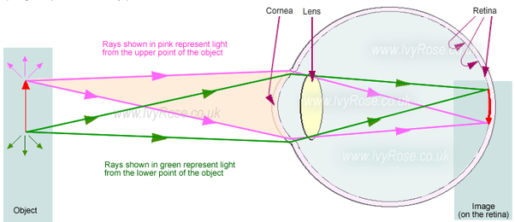
When we look at an object, light reflected from it enters the eye and is refracted, or bent. This creates a focused, upside-down image of the object that the brain will have to interpret and turn in the correct direction.

Slide 6
Structure of the eye
Part of the eye | Function
Conjunctiva | Highly vascularised. Thin layer of clear mucous membrane that helps lubricate the eye, covering the anterior sclera (and lining the inner surface of eyelids).
Cornea | Transparent, avascular connective tissue at the front of the eye where light enters and is bent (refracted). transparent, covering the anterior 1/6th of the eye.
Aqueous humour | Watery liquid filling the front of the eye. It is responsible for the nourishment of both the lens and the cornea.
Iris | Controls the amount of light entering the eye. Most anterior extension of the choroid and separates the anterior and the posterior chambers.
Pupil | Hole/ Opening in the iris that allows light to enter the eye.
Lens | A transparent bi-convex disk, can change shape to focus light onto the retina.
Ciliary muscles | Attached to sclera and ciliary body and control the shape of the lens by changing the thickness of the lens when focusing.
Suspensory ligaments | Hold the lens in place.

Slide 7
Part of the eye | Function
Vitreous humour | Transparent jelly-like substance which supports the back of the eye.
Sclera | Tough, white/ opaque, protective outer layer that is heavily vascularized connective tissue and covers the posterior 5/6th of the eye. It is continuous with the clear cornea.
Choroid | Highly vascular, pigmented layer in the posterior 2/3rd of the eye, meaning black layer that contains many blood vessels.
Retina | Light sensitive layer. It contains rod cells that work in dim light and cone cells that detect light of different colours, and details.
Fovea (Yellow spot) | The most sensitive part of the retina. Contains mostly cone cells.
Blind spot | The point where the optic nerve attaches to the eye. There are no light sensitive cells here.
Optic nerve. | Carries nerve impulses away to the brain.

Slide 8
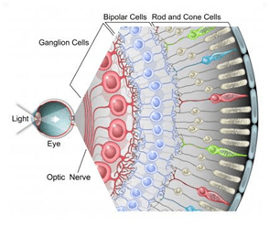
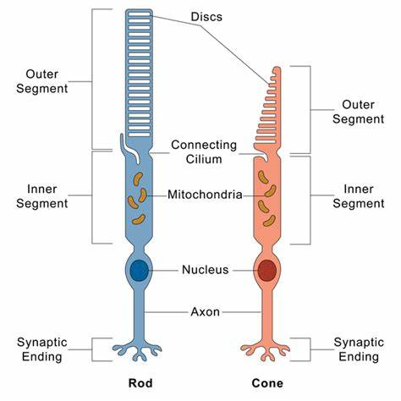
Light sensitive cells
Inside the eye are photoreceptors, which create nerve impulses when struck by light. There are two types: cones make color vision possible, and rods specialize in black-and-white images.

Slide 9
Light sensitive cells
Type of cell | What do they detect? | Light conditions | Information.
Cones | Colour (three different colours) | Bright light (high intensity) | Most are found tightly packed around the fovea in the centre of the retina. They produce a sharp image.
Rods | Black and white | Dim light (low intensity) | Most are found around the outside of the retina. They show a less detailed image.

Slide 10
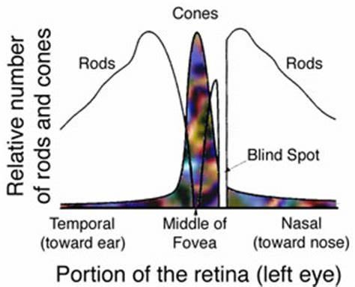
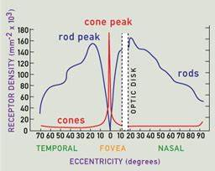
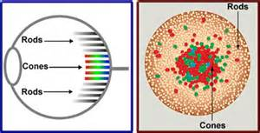
Distribution of Light sensitive cells

Slide 11
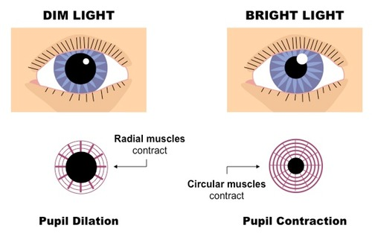
Pupil/ Iris reflex

Slide 12
Pupil/ Iris reflex
Conditions | Circular muscles | Radial muscles | Pupil diameter | Effect
Bright | Contract | Relax | Narrower | Less light enters the eye.
Dim | Relax | Contract | Wider | More light enters the eye.

Slide 13
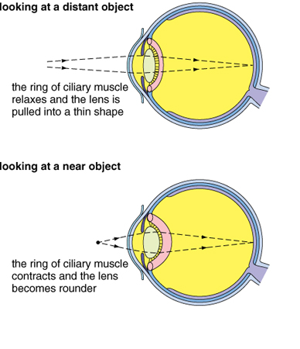
Accommodation
CCC-Mnemonic

Slide 14
Accommodation
Object | Ciliary muscles | Suspensory ligaments | Lens shape
Close | Contract | Slacken | Becomes shorter and fatter/ thicker
Distant | Relax | Tighten | Becomes longer and thinner.

Slide 15
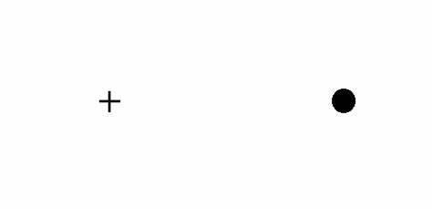
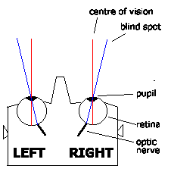
Blind spot test
Extension- You can also try:
Step 5. repeat step 1-3, but this time, close your right eye, and look at the cross with your left eye.
Q: Does the dot disappear this time? Why?
Step 1. Put your face about 40cm from this image.
Step 2. Close your left eye, and look at the cross with your right eye.
Step 3. Gradually move your face closer to the image.
Q: What happens? Can you explain it?
Q: Which eye’s blind spot did you just find out?
What is its position relative to the fovea?
Step 4. repeat step 1-3, but this time, close your right eye, and look at the dot with your left eye.
But why did not we realize we have blind spots?

Slide 16
